Slide 1
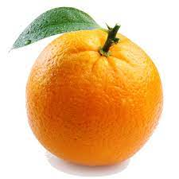
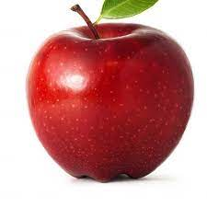






Slide 2
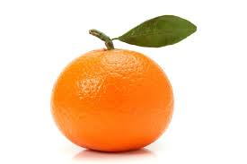



Slide 3
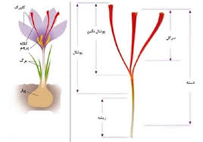




Slide 4
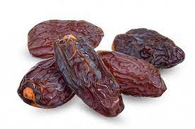
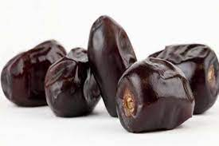




Slide 5
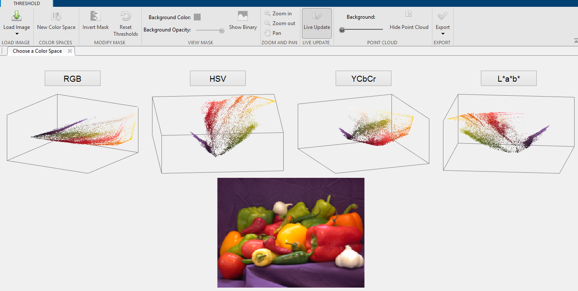
colorThresholder

Slide 6
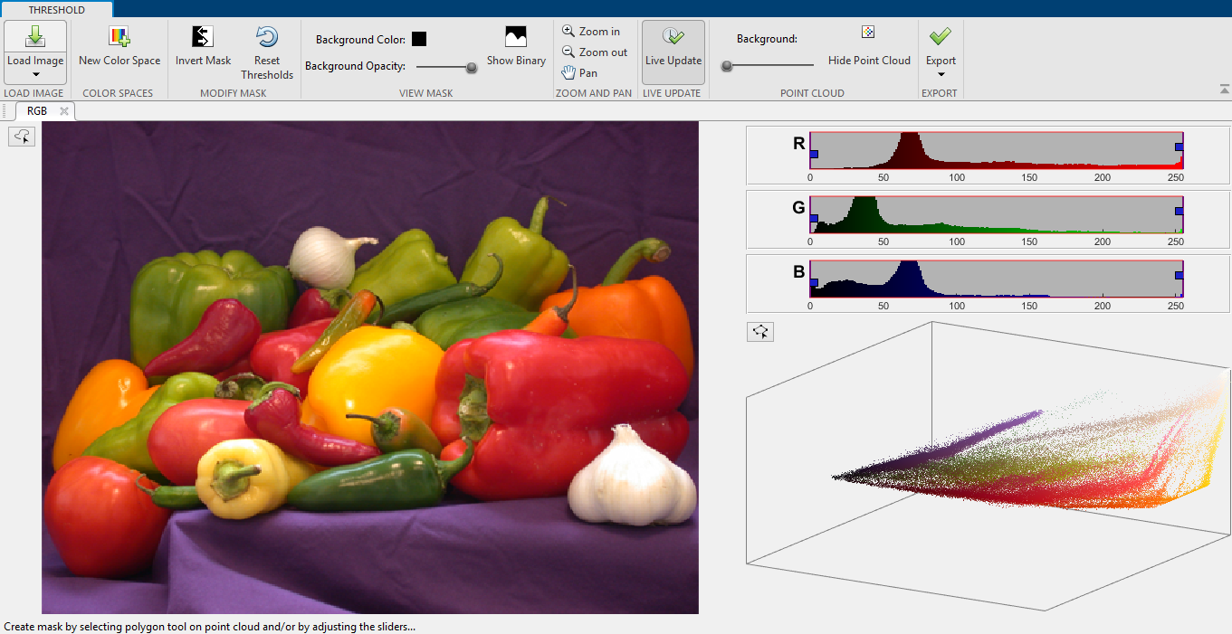

Slide 7
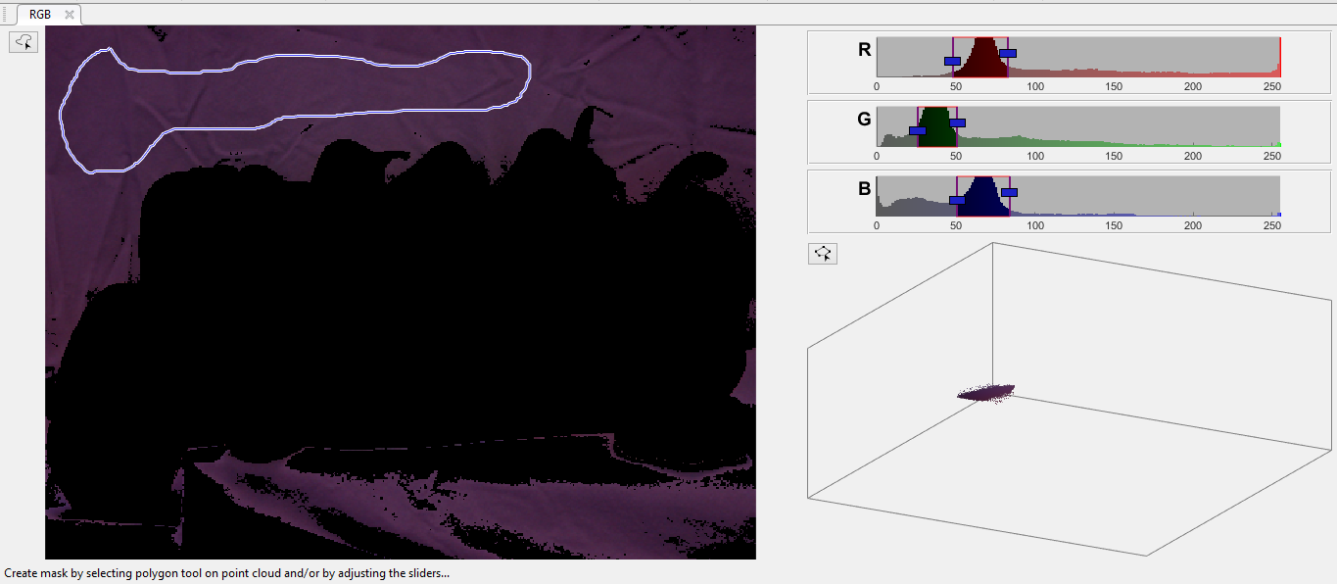




Slide 8
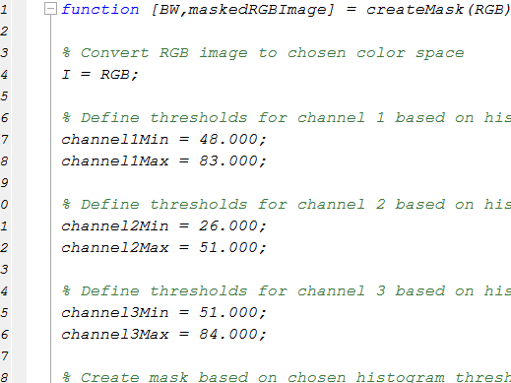

Slide 9

Hue - Ink Mixing
Subtractive mix of transparent inks
Primary: CMY
Secondary: RGB
~Black: C + M + Y
Actually use CMYK
to get true black

Slide 10
Hue - Ink Mixing
Assumption: ink printed on pure white paper
CMY = White – RGB:
  C = 1 – R, M = 1 – G, Y = 1 – B
CMYK from CMY (K is black ink):
  K = min(C, M, Y)
  C = C – K, M = M – K, Y = Y - K

Slide 11

Hue - Light Mixing
Additive mix of colored lights
Primary: RGB
Secondary: CMY
White = R + G + B
Show demonstration of optical mixing

Slide 12

Saturation
Purity of color

Slide 13
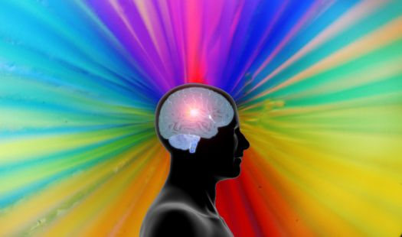
Perception of Color
In the end, color is a perceptual phenomenon

Slide 14
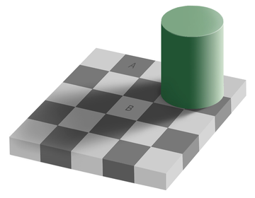
Color Constancy
Perceived color is highly context dependent
Allowing color recognition with variable lighting conditions

Slide 15
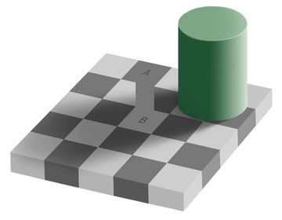
Color Constancy
Perceived color is highly context dependent
Allowing color recognition with variable lighting conditions

Slide 16


Simultaneous Contrast

Slide 17

Simultaneous Contrast

Slide 18
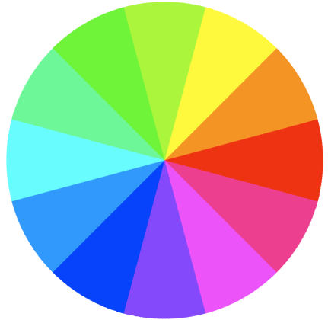
RGB Color Wheel
Warm/Cool
Complements
Split Complement
Analogous
Show RGB Cube

Slide 19
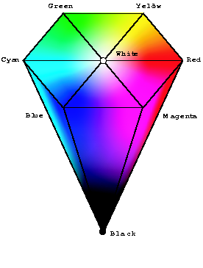
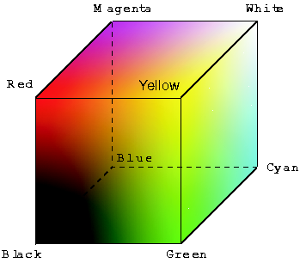
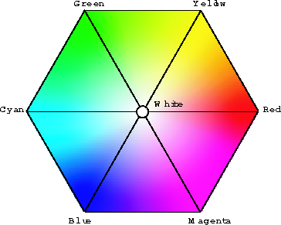
HSV Color Model
  RGB cube
  HSV top view
  HSV cone
HSV is a projection of the RGB space

Slide 20
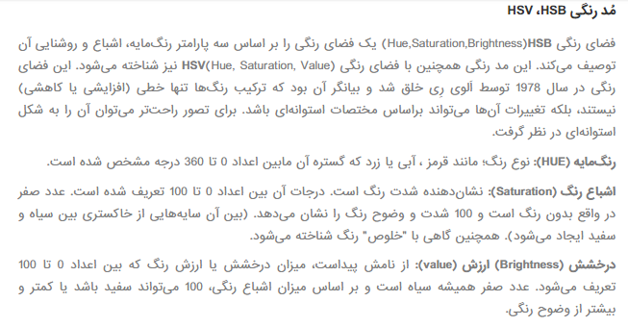

Slide 21
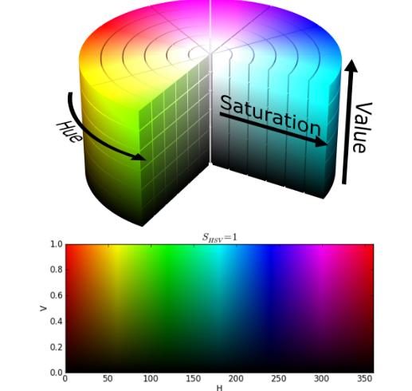

Slide 22
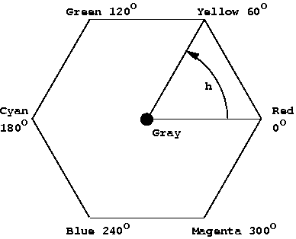
HSV Color Model
Hue, an angular measure (0 … 360)

Slide 23
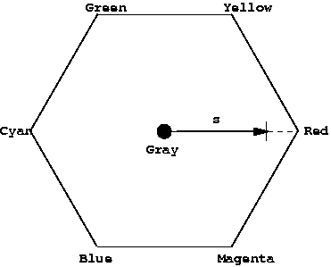
HSV Color Model
Saturation, a fractional measure (0.0 … 1.0)

Slide 24
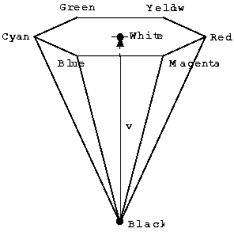
HSV Color Model
Value, a fractional measure (0.0 … 1.0)

Slide 25
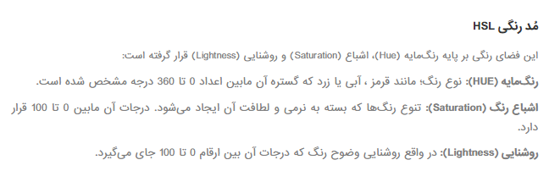

Slide 26
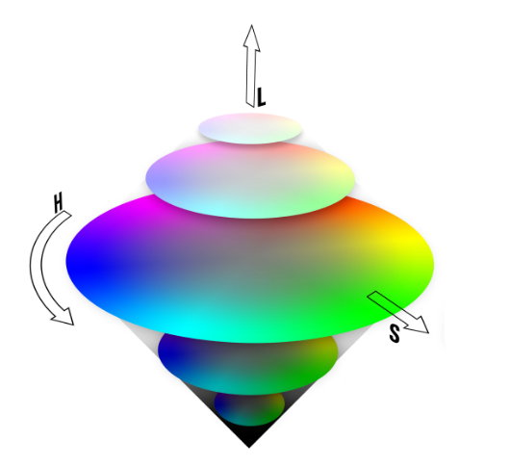

Slide 27

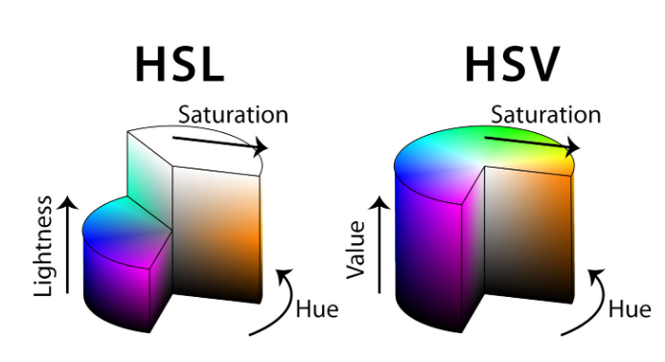

Slide 28
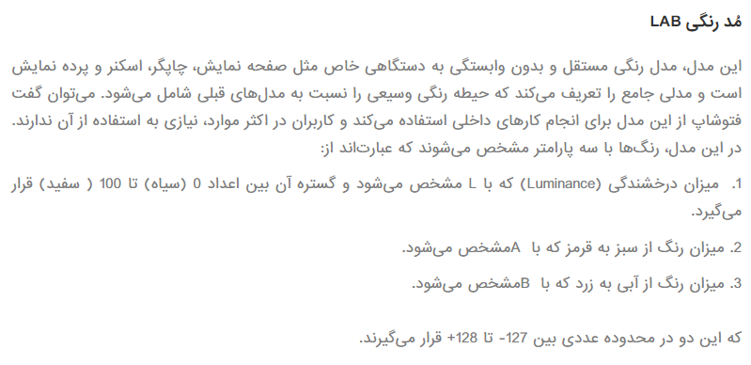


Slide 29
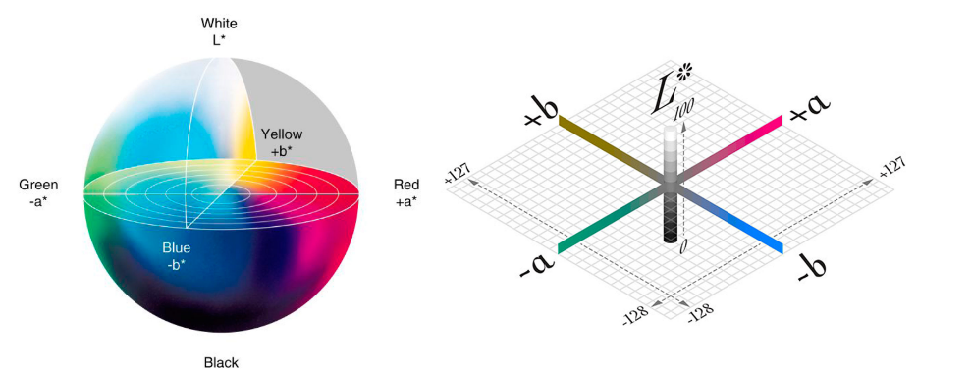


Slide 30
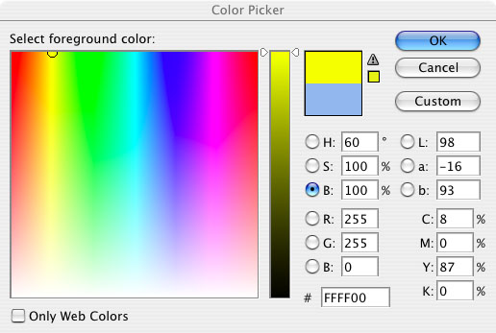
Color Picker

Slide 31







Slide 32
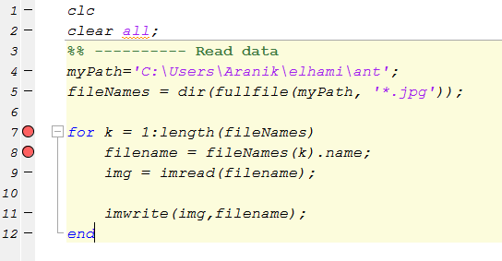











Slide 33
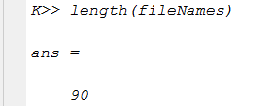


Slide 34





Slide 35



Slide 36
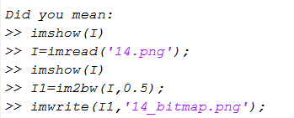

Slide 37

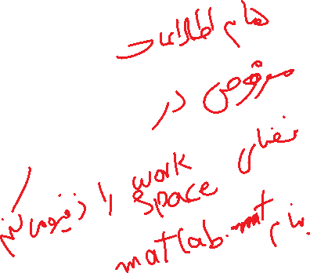



Slide 38
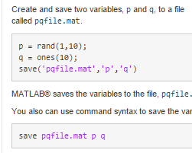









Slide 39

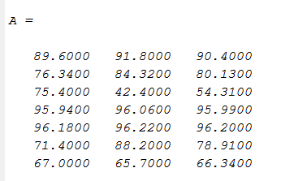





Slide 40
End

